Slide 1
Frontend Hackathon
Progress report (Bakery or restaurant page)
Time completed: 36 hours

Slide 2
Components added/changes made
Reservation section
Minor bug fixes
Improved styling in the opening section

Slide 3
Booking section
(Next slide)

Slide 4
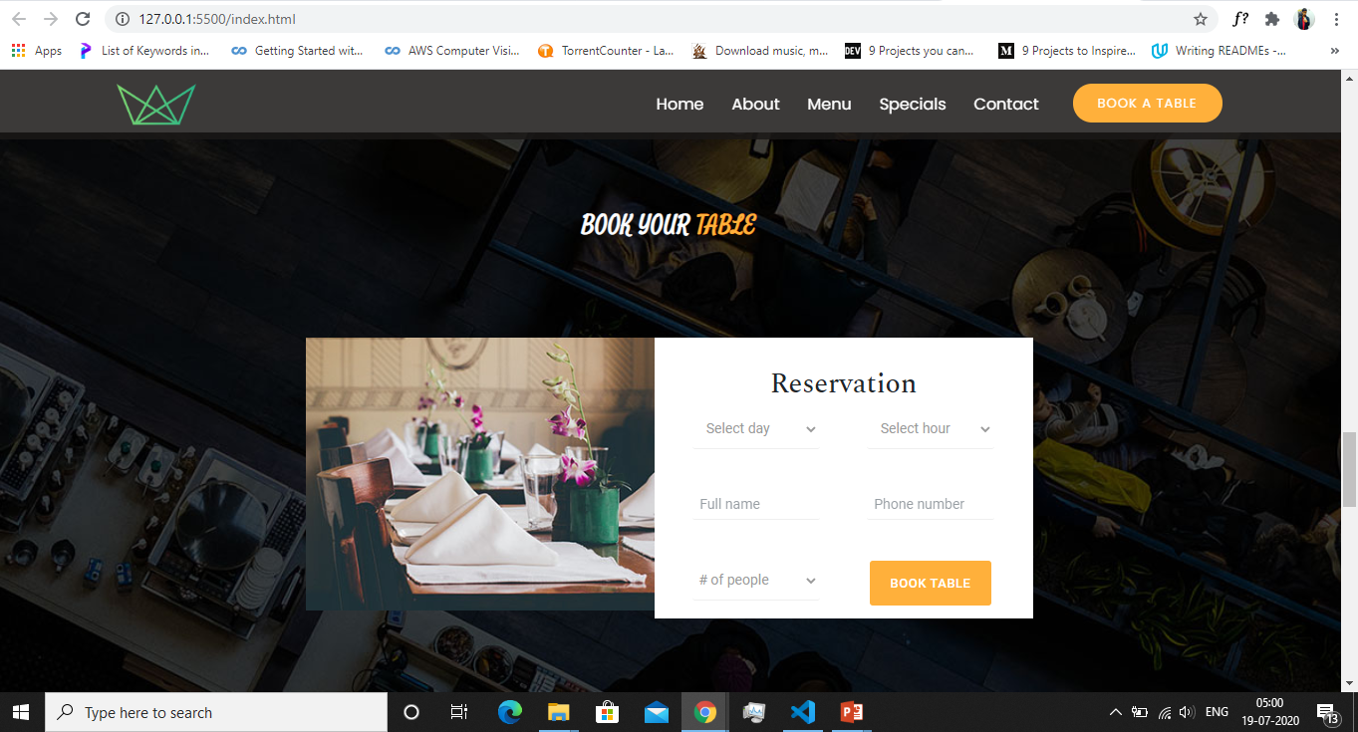

Slide 5
Reservation Section
Added a reservation section which the customers could use to make a reservation at the restaurant.
Added a nice scrolling effect in the background image as we scroll down this section
Made purely with html and css.

Slide 6
Opening section
(Next slide)

Slide 7
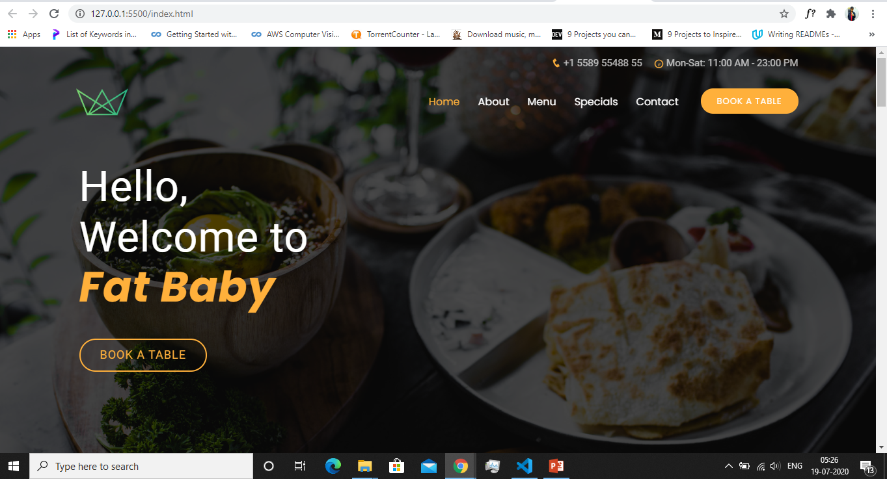

Slide 8
Opening Section
Added a nice scrolling effect like parallax in the background image using html and css.
Changed the background image and a bit of styling.

Slide 9
Future Plans
Make edits in the opening section.
Add a testimonial section to the page
Add a footer*
Add a premium section that displays three exotic/best dishes of the restaurant.
Refactor the code.

